Slide 1
09-09 Python code syntax highlights

Slide 2
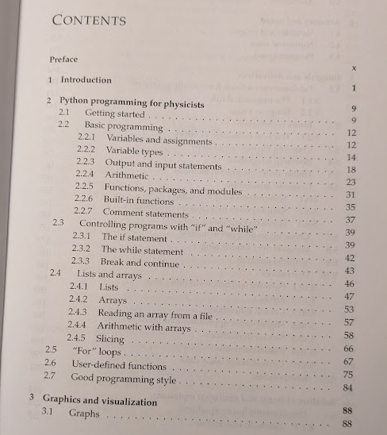

Slide 3
Math with different variable types is tricky. Avoid it if you can, worry about it if you can’t.
2+2 =
2+2.0 =
2*2.0=
type(2.0)
type(2)
type(a) vs type(“a”)
10/2 =
10/2.0 =
int(10)/int(2)
10//2 =
10//2.0 =
13%5 =

Slide 4
Is there anything wrong with this?
i = 2
dx = 0.5
x0 = 4.8
x1 = x0 + i*dx
Vs
x1 = x0 + float(i)*dx

Slide 5



Math…
sqrt(25.0)
import math
math.exp(1)
math.log(math.exp(4))
https://docs.python.org/3/library/math.html
a=1+2j
2a =
a+3j =
a*a =
a**2 =
https://docs.python.org/3/library/cmath.html

Slide 6
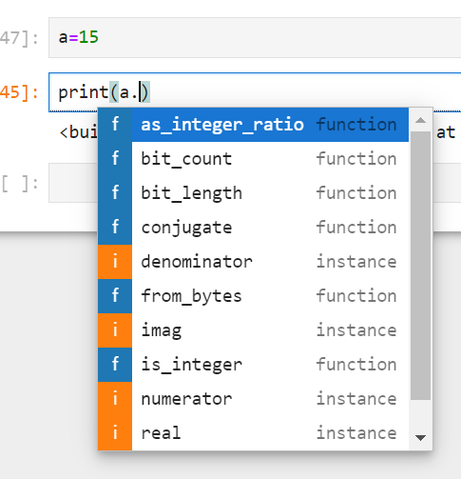
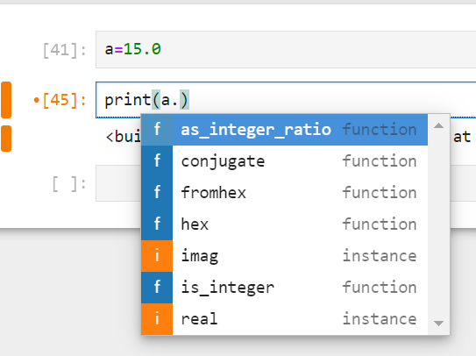
Every variable has built-in properties/functions (via tab)

Slide 7




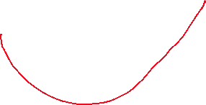

If and While
arg==0 vs abs(arg)<1e-9
Tabs indicate scope of if
a=
b=
c=
arg=b*b-4*a*c
If (arg<0) :
print("Are you sure about your life choices?\nImaginary roots!")
elif (arg==0):
print("should be just one root?")
else:
print("normal roots")
x1=(-b*+(b*b-4*a*c)**0.5)/(2*a)
x2=(-b*+(b*b-4*a*c)**0.5)/(2*a)
print(x1,x2)

Slide 9
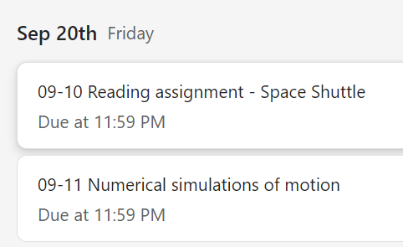
Wednesday 09-11
If, While, Lists
Numerical Motion Simulations

Slide 10



If and While
Is using break bad practice? Maybe.
Why?
It's confusing, and reminiscent of "goto"
You should make loops well and obviously controlled.
Predictable code execution runs faster (maybe?)
k=1
while(k<3):
print(k)
k = k+1
# vs
k=1
while(True):
print(k)
k = k+1
if (k==3):
break

Slide 11

Lists and arrays
# common
# read a in from file and get
a = [1,2,2,3,4]
print(len(a))
for c in range(len(a)):
print(b,b**2)
# Uncommon
A=[1,2,3,”potato”]
print(A[1])
# Common
N=4
dx=0.1
X0=3
for i in range(N):
a.append(i*dx+x0)

Slide 12
For (each) loops – iterate over counter or list
a = [1,2,2,3,4]
for b in a:
print(b,b**2)
a = [1,2,2,3,4]
print(len(a))
for c in range(len(a)):
print(b,b**2)

Slide 13
Plotting/Graphing
Matplotlib https://matplotlib.org/
Matlab/Octave https://octave.org/
Gnuplot http://www.gnuplot.info/

